Slide 1
SECURITY FOR NETWORKED SYSTEMS
Final Project
IMAGE TRAGICK
(CVE-2016-3714)
By
Haritha Damarla
Prashanth Swargam

Slide 2

Remote Code Execution ImageMagick - Tragick
Ability of an attacker to access the remote system and perform arbitrary code execution
ImageMagick is a software used to process images (conversion from one format to another, resizing, etc)
ImageTragick is the vulnerability that is found in ImageMagick software, which lead attackers to perform Remote Code Execution

Slide 3
Problem - Motivation
Replicate Remote Code Execution through vulnerability in ImageMagick
CVE-2016-3714 – ImageTragick – One of the top 10 vulnerabilities in 2016
Remote Code Execution is observed in versions older and including 6.8.4-10 of ImageMagick.

Slide 4
Working of ImageMagick
ImageMagick parses all the images in the form of Magic Vector Graphics
It contains its features in the form of delegates – delegates.xml
Images can use this features in their Magic Vector Graphics by invoking delegates.
Usability and restrictions on delegates are defined by policies – policy.xml

Slide 5
Terminology
delegates.xml file
- contains definitions of delegates in the software
policy.xml file
policy.xml is a security policy configuration file
It has information about the accessibility of delegates
Magic Bytes in an Image
- Specialized character set to identify type of an image
- For eg: 89 50 4E 47 0D 0A 1A 0A in png file

Slide 6
Approaches
Define policies to enforce restrictions on the user inputs
Check not only the extension, but the contents of the header file and decide whether to store the file on server or discard it
Magic Bytes :
Specialized character set to identify type of an image
For eg: 89 50 4E 47 0D 0A 1A 0A in png file
Keep updating your software to the latest versions for the patches

Slide 7
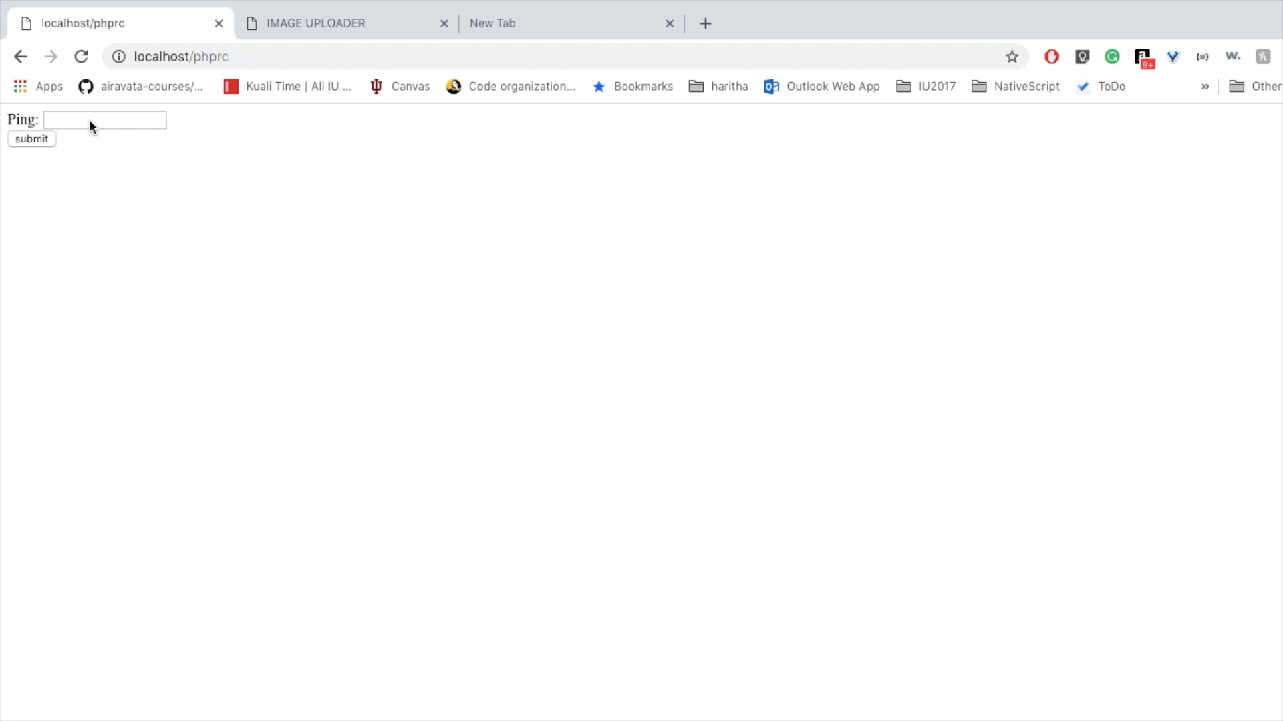
Demo

Slide 8
https://youtu.be/-MBb86lTDcI

Slide 9
Thank you
Have a Secure World

